Slide 1
Analysis of Lucia:
A Cognitive Model of Language Comprehension
Peter Lindes
Soar Workshop
9 May 2019

Slide 2
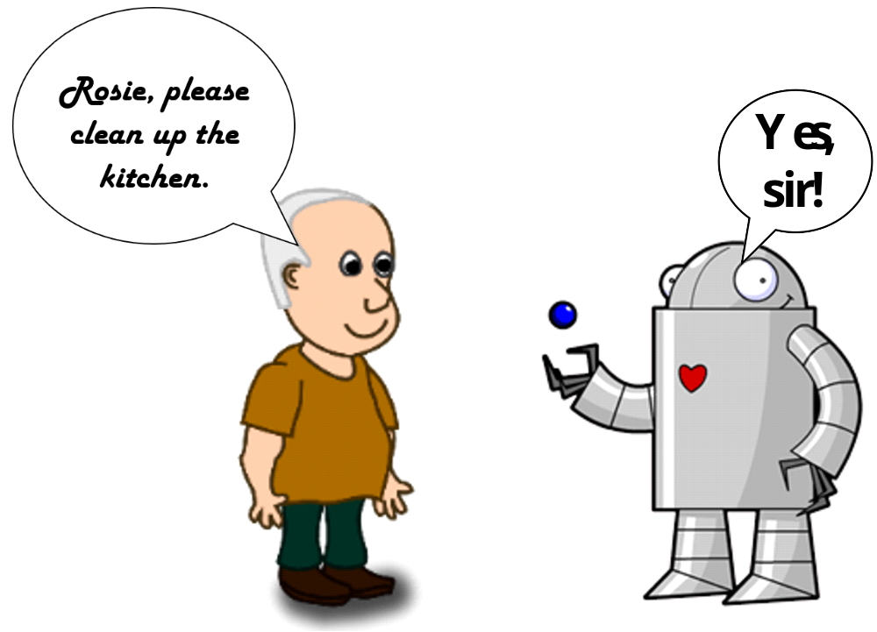
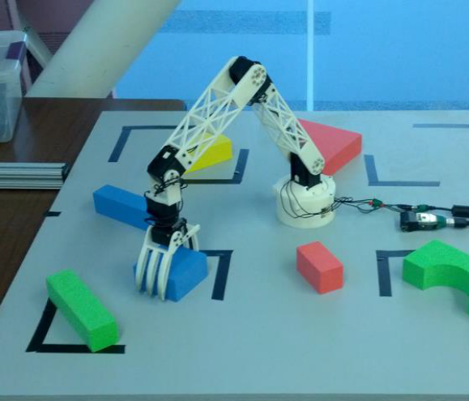
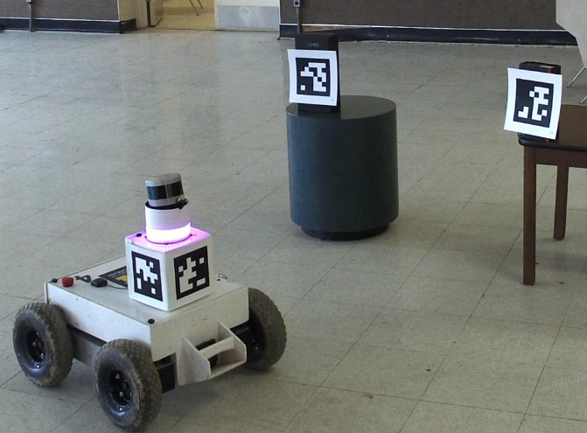
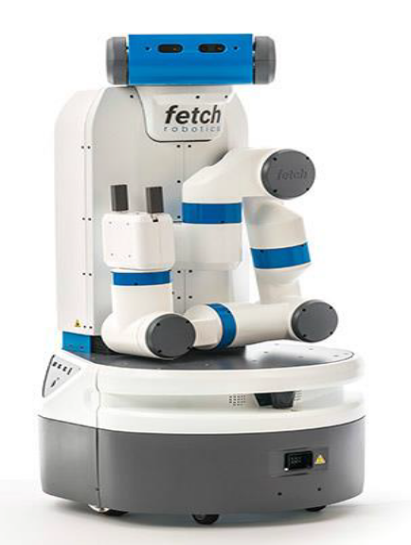
Rosie
Interactive Task Learning in a Soar agent
Learns games and puzzles (Kirk and Laird, ACS 2016)
Learns fetch and delivery tasks (Mininger and Laird, ACS 2016)
ROSie
Does it all

Slide 3
Agenda
Human language comprehension
Review of Lucia
Analysis of the grammar
Development of the grammar
The processing system

Slide 4
How do humans comprehend language?
Behavior
  Form -> Meaning
  Learn in increments
Processing
  Incremental
  Immediate interpretation
Physical mechanisms
  The brain

Slide 5
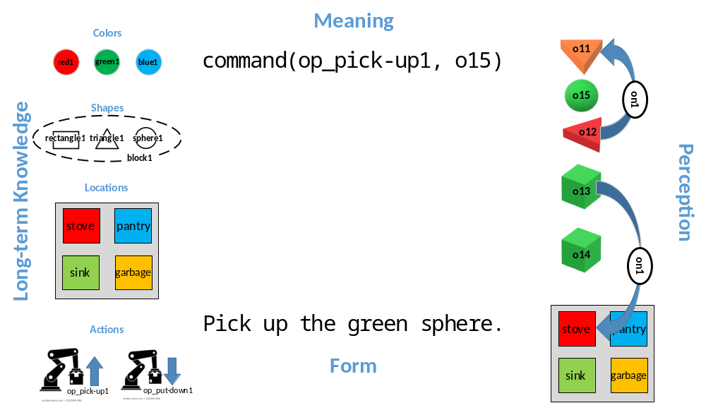
Behavior: Map Form to Meaning
?

Slide 6
Architecture + Knowledge = Behavior

Slide 7
The Lucia Grammar for Rosie
Maps form -> meaning in small increments
Compositional hierarchy
Type hierarchy
Written in the ECG formalism
Developed from a set of 207 Rosie sentences
Ongoing development to cover more tasks

Slide 8
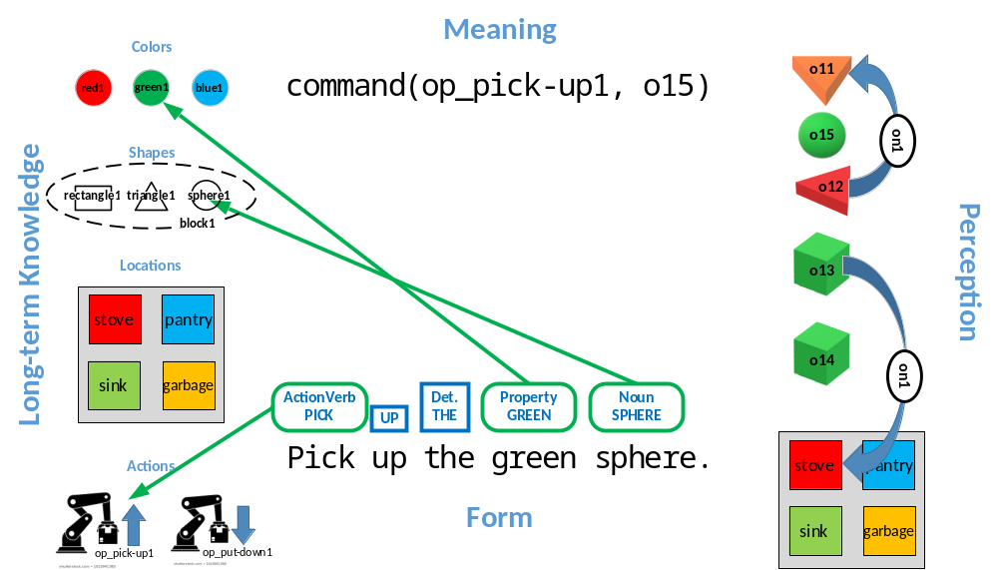
Lexical Items

Slide 9
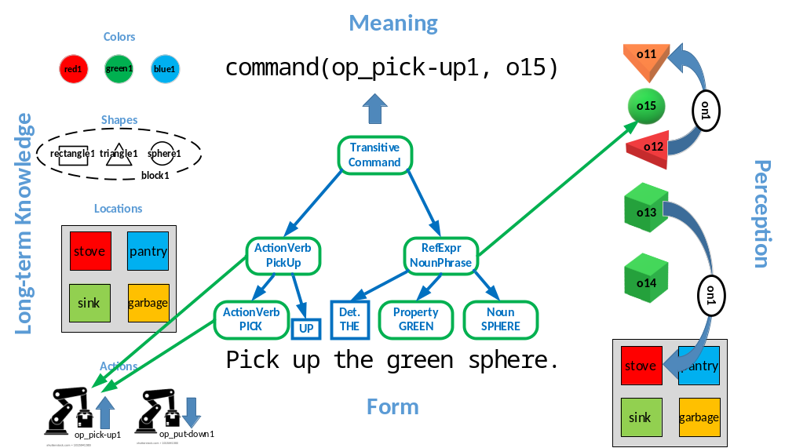
Composition

Slide 10
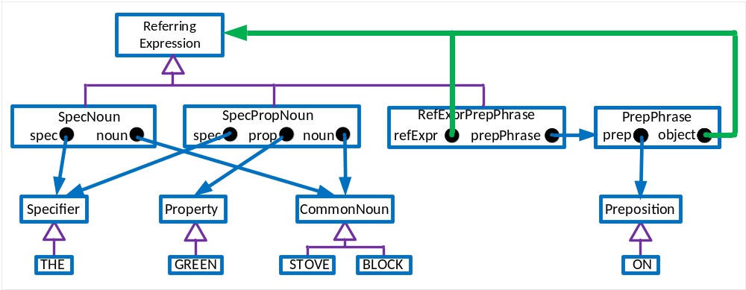
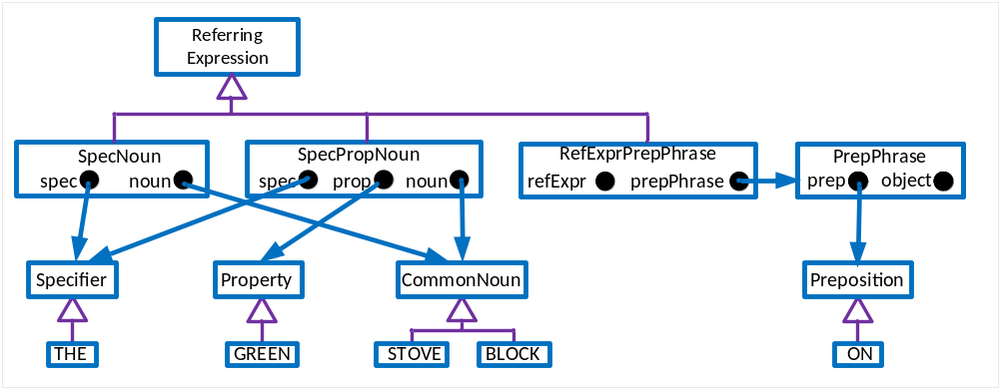
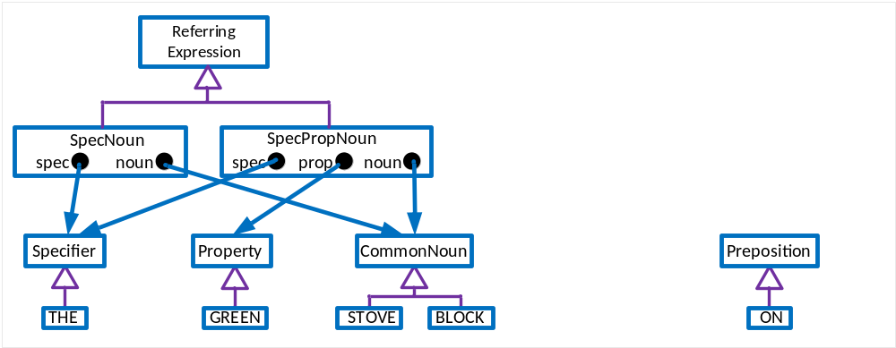
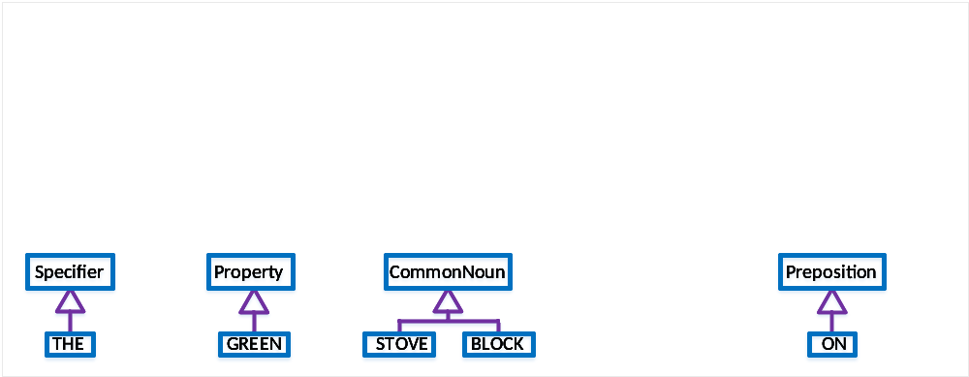
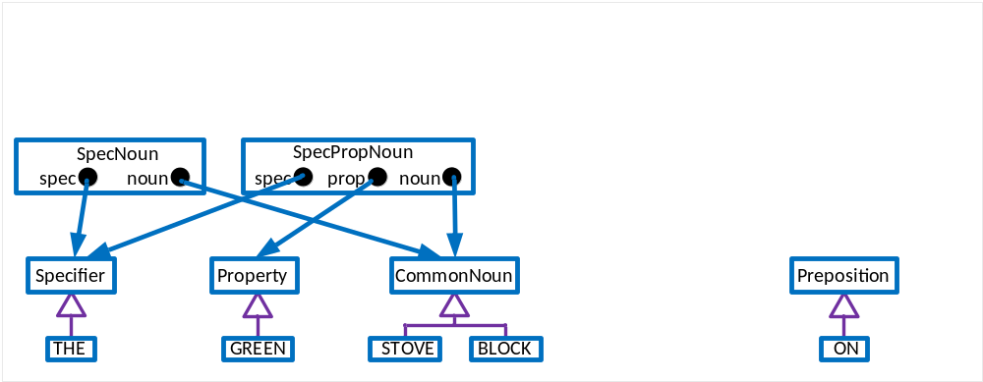



A Section of the Grammar

Slide 11
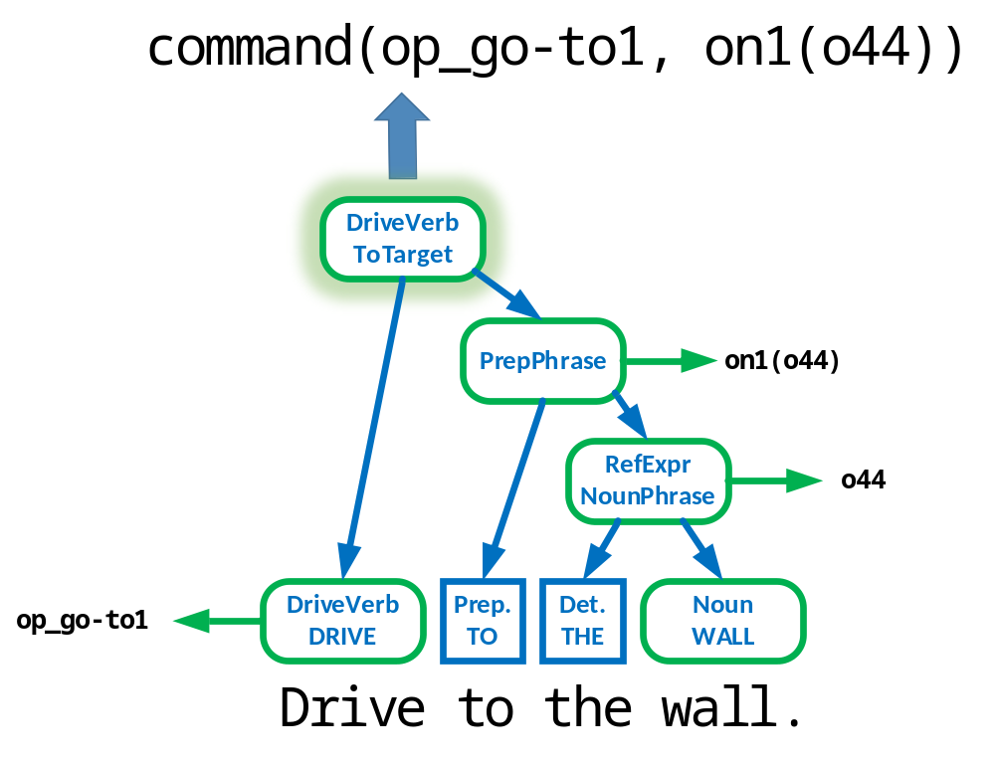
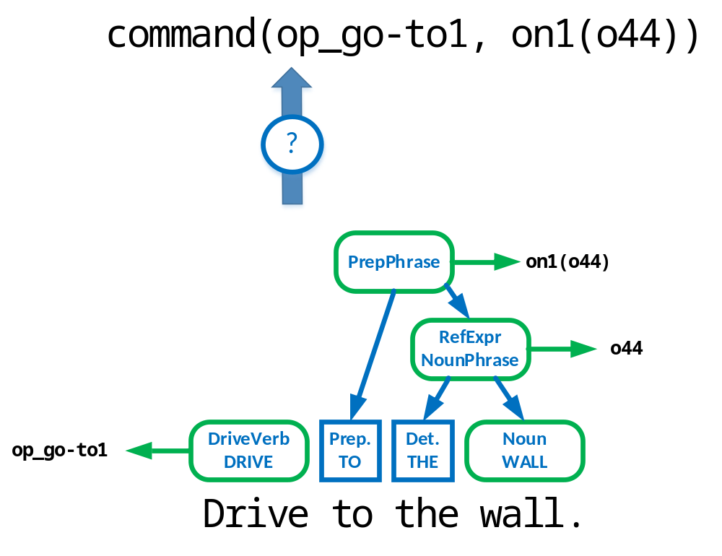
Behavior: Learning in Increments

Slide 12
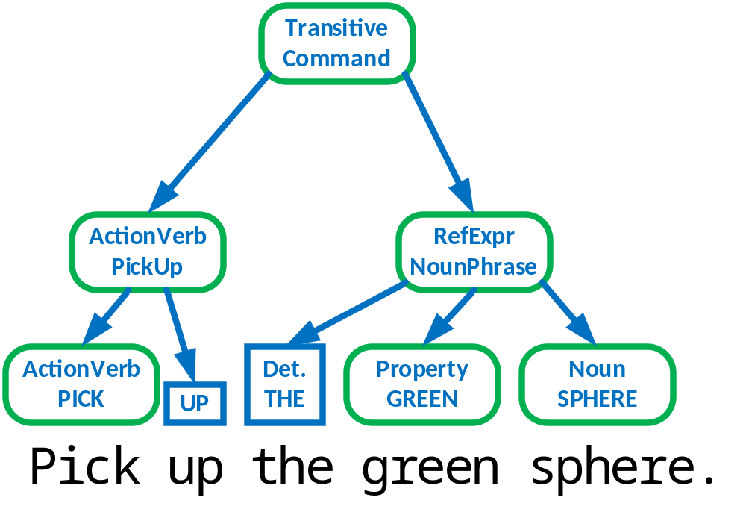
Processing: Incremental
In processing a sentence, we try to extract as much information as possible from each word and spend some additional wrap-up time at the end of each phrase. John R. Anderson, 1995, p. 385.
5c
2b
5b
1
3
4
5a
2a

Slide 13
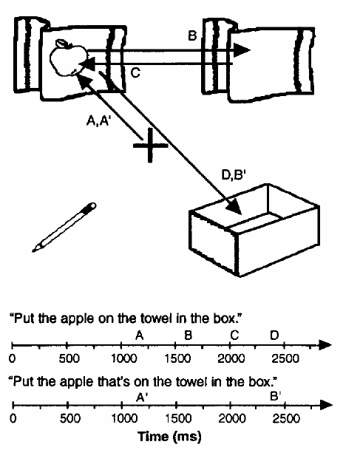
Processing: Immediate Interpretation
Move
the green rectangle
to the left of
the large triangle
to the pantry.
Move the green block
that is on the stove
to the pantry.
Tanenhaus, Michael K., Michael J. Spivey-Knowlton, Kathleen M. Eberhard, and Julie C. Sedivy (1995). Integration of Visual and Linguistic Information in Spoken Language Comprehension. Science 268:1632-1634.

Slide 14
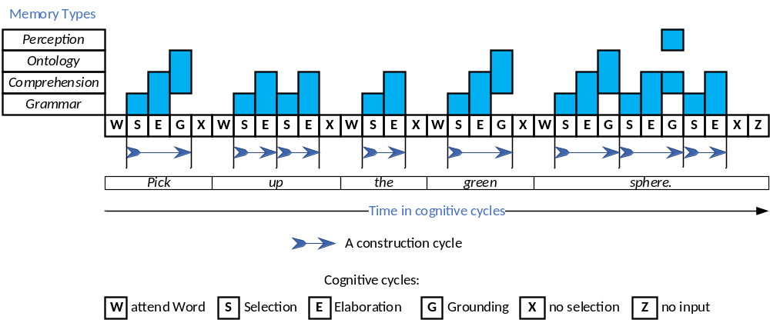
Processing One Construction at a Time

Slide 15


How do humans comprehend language?
Behavior
  Form -> Meaning
  Learn in increments
Processing
  Incremental
  Immediate interpretation
Physical mechanisms
  The brain

